Slide 1
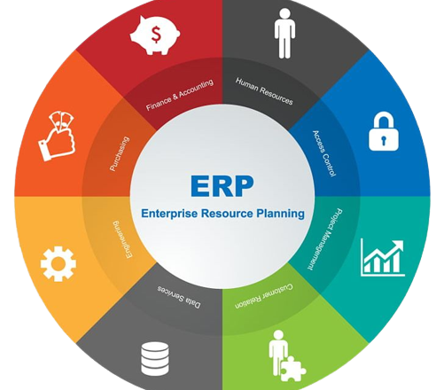
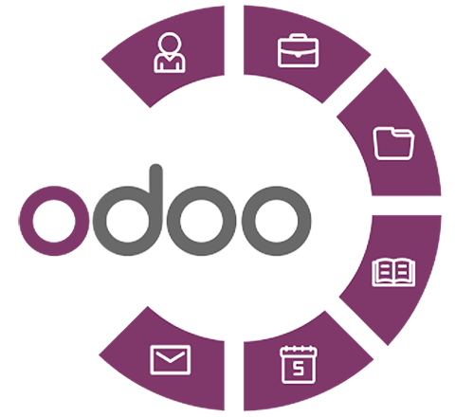
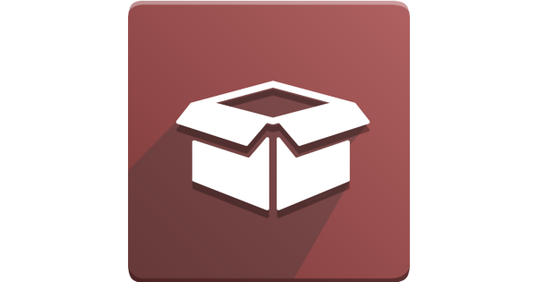
Presentation Outline
Enterprise Resource Planning (ERP)
Odoo ERP
Odoo Inventory Module
Presented By:
Aung Myat Thu
Zaw Thu Htet
Thin Ei San

Slide 2
Agenda
Enterprise Resource Planning (ERP)
Introduction
Types of ERP
Use of ERP

Slide 3
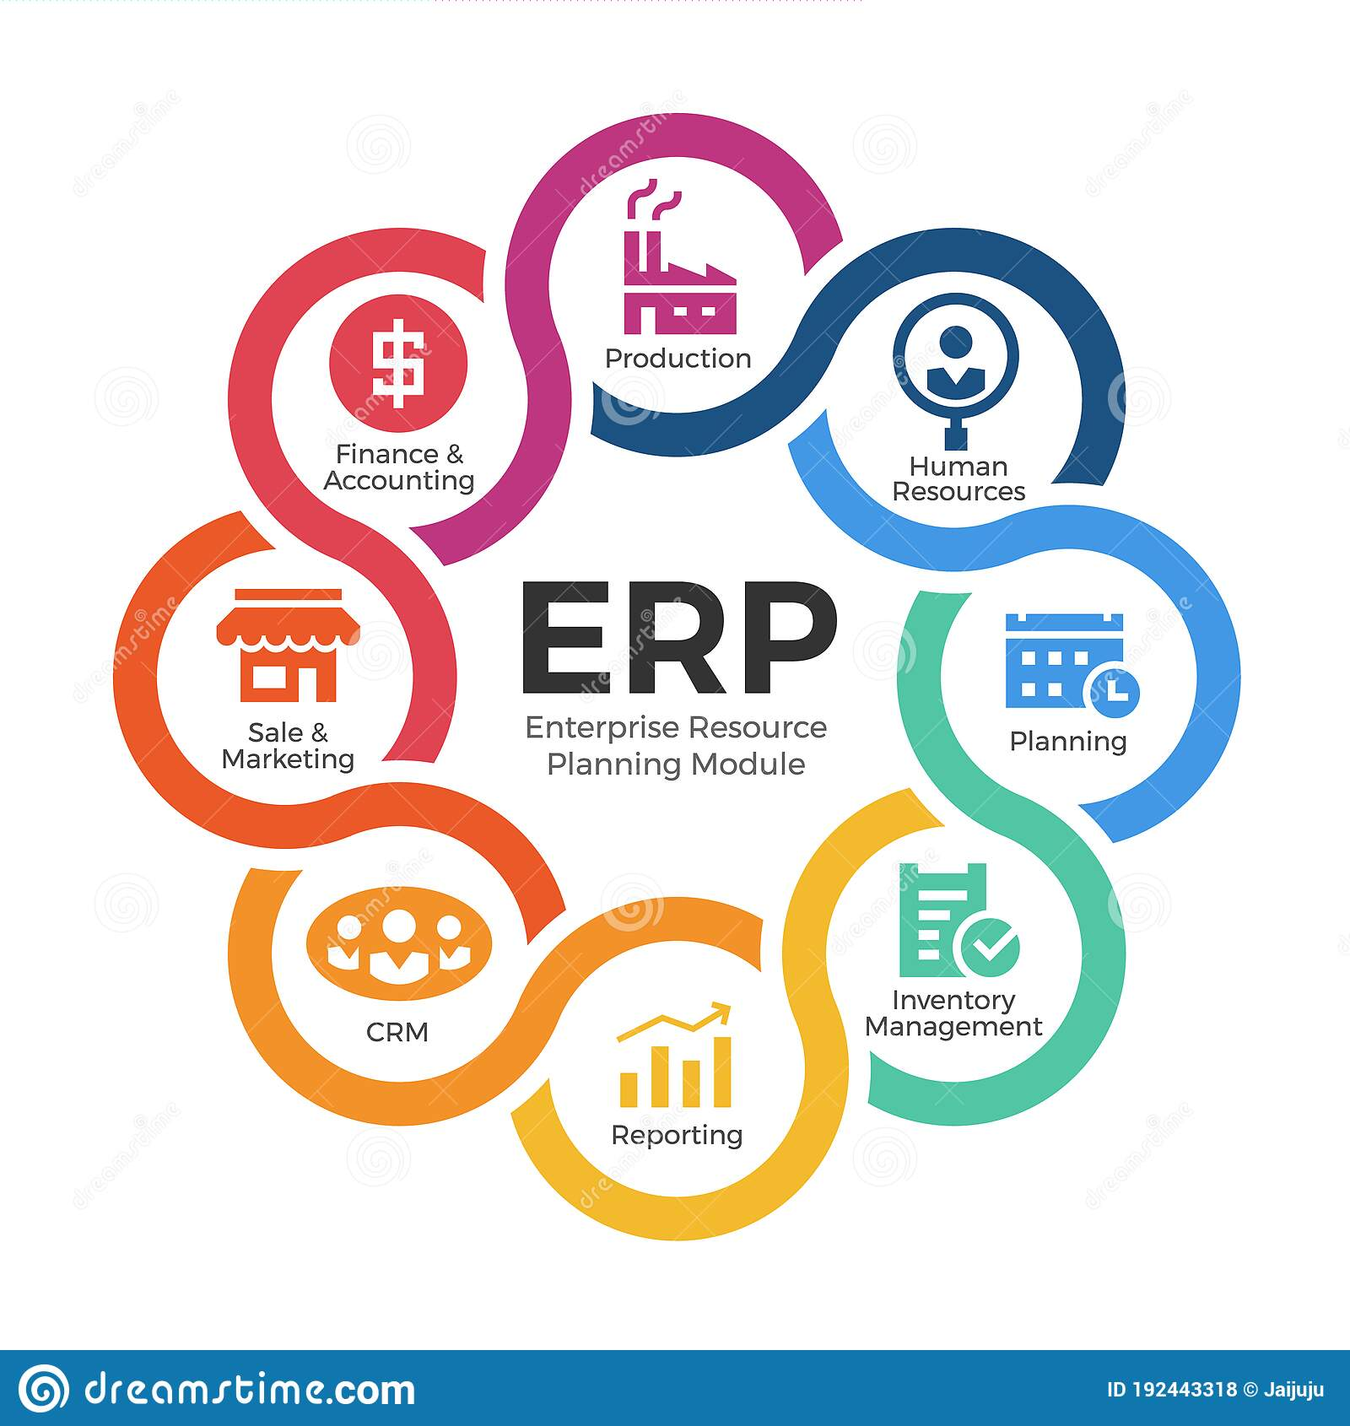
Introduction
What is ERP?
Enterprise resource planning (ERP) refers to a type of software that organizations use to manage day-to-day business activities such as Accounting, Sale & Marketing, CRM, Reporting, Inventory Management, Planning, Manufacturing and HR.
3

Slide 4
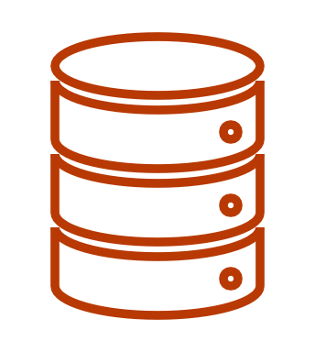


Types of ERP
On-Premise ERP
On-premise ERP software is enterprise resource planning software that runs on in-house servers at your own location, or at locations under your control.
Cloud ERP
Cloud ERP systems are accessible from anywhere, are nearly always online, and don't require the same company IT resources for maintenance and upgrades.
Hybrid ERP
4

Slide 5
Use of ERP
Why use ERP?
Enhanced Business Reporting
Improved Productivity
Better Customer Service
Better Data & Cloud Security
Business Process Improvement

Slide 6

Odoo ERP

Slide 7
Agenda
Introduction
Advantages of Odoo

Slide 8
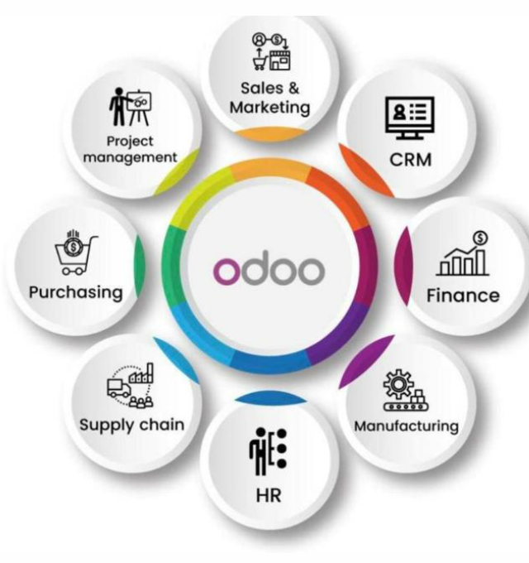
INTRODUCTION
Odoo is All-in-one Business Software Solution, known as OpenERP
Odoo is a suite of business management software tools
For example,
Sales & Marketing, CRM, Finance, Manufacturing, HR, Supply Chain, Purchasing, Project Management, and Inventory Management.

Slide 9
Advantages of Odoo
Modular software
Open source
Customization
Advanced Technology Support

Slide 10
Odoo Inventory Module
10

Slide 11
Inventory Module of Odoo
Inventory management is important for businesses of any size.
Odoo Inventory Module helps businesses manage their products or assets inventory.
It helps you to manage the process of ordering, storing, consuming and selling.
It is the best inventory & tracking system for warehouse management.

Slide 12
Content of Inventory Module
Inventory Module Basic Work Flow
Overview of Inventory Module
Configuration
Products in Inventory
Inventory Operations
Reporting

Slide 13
Warehouse
Sale
Start
Raw
Material
Purchase
Stock In
Products
Settlement
Raw Material
Or
Products
Raw Materials
Products
Shipping
Production
Production
Inventory Module Basic Work Flow
Finished Products
Stock In
Finished Products
Stock Out
Shipping
Settlement
End

Slide 14
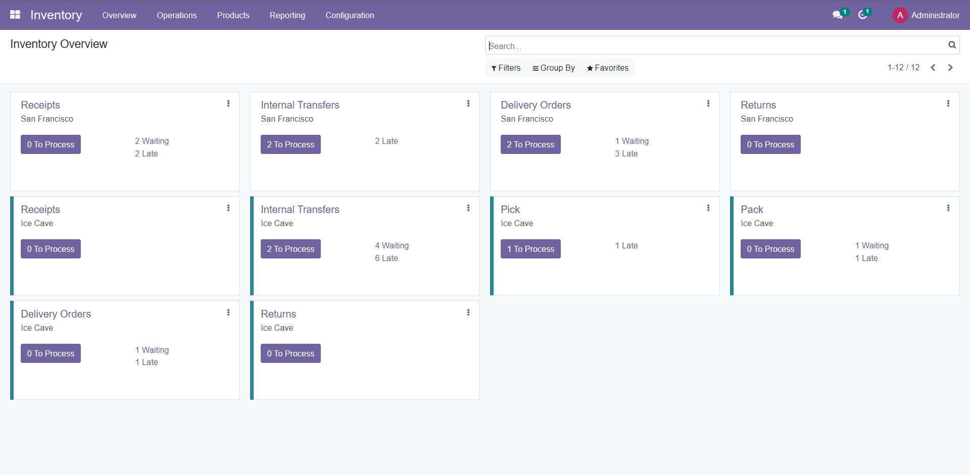
Overview of Inventory Module

Slide 15
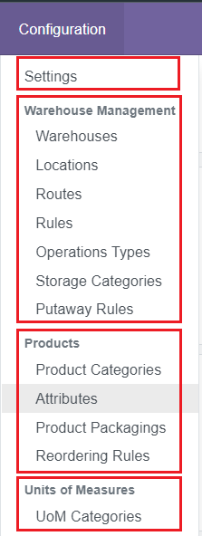
Configuration
Setting for Configure Inventory Feature
Warehouse Management Feature
Configuring Products in Inventory
Units of Measures(UoM) Configuration

Slide 16
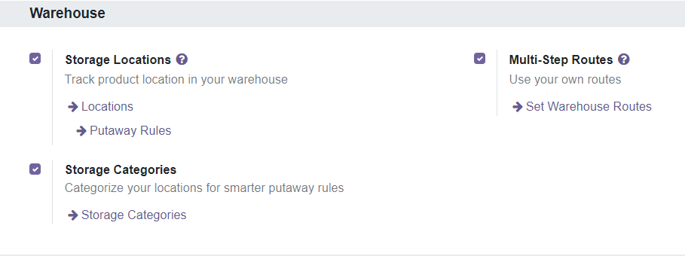
Configuration -> Setting
Warehouse Setting Configuration

Slide 17
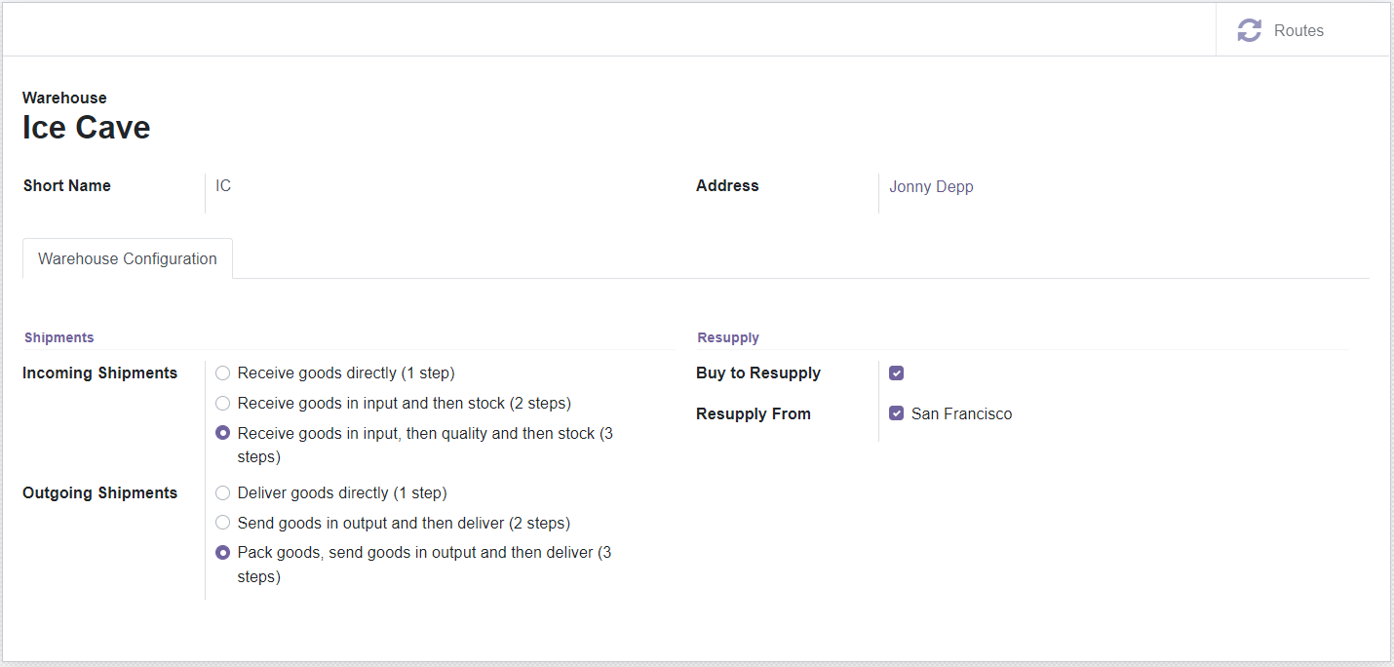
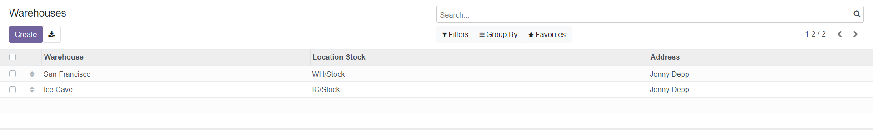
Configuration -> Warehouse Management
Setting up Warehouse

Slide 18
Routing
Routes are a collection of Push and Pull Rules, Odoo helps you manage advanced route configurations such as:
  Manage product manufacturing chains.
  Manage default locations per product.
  Define routes within the stock warehouse according to business needs, such as quality control, after-sales services, or supplier returns.

Slide 19
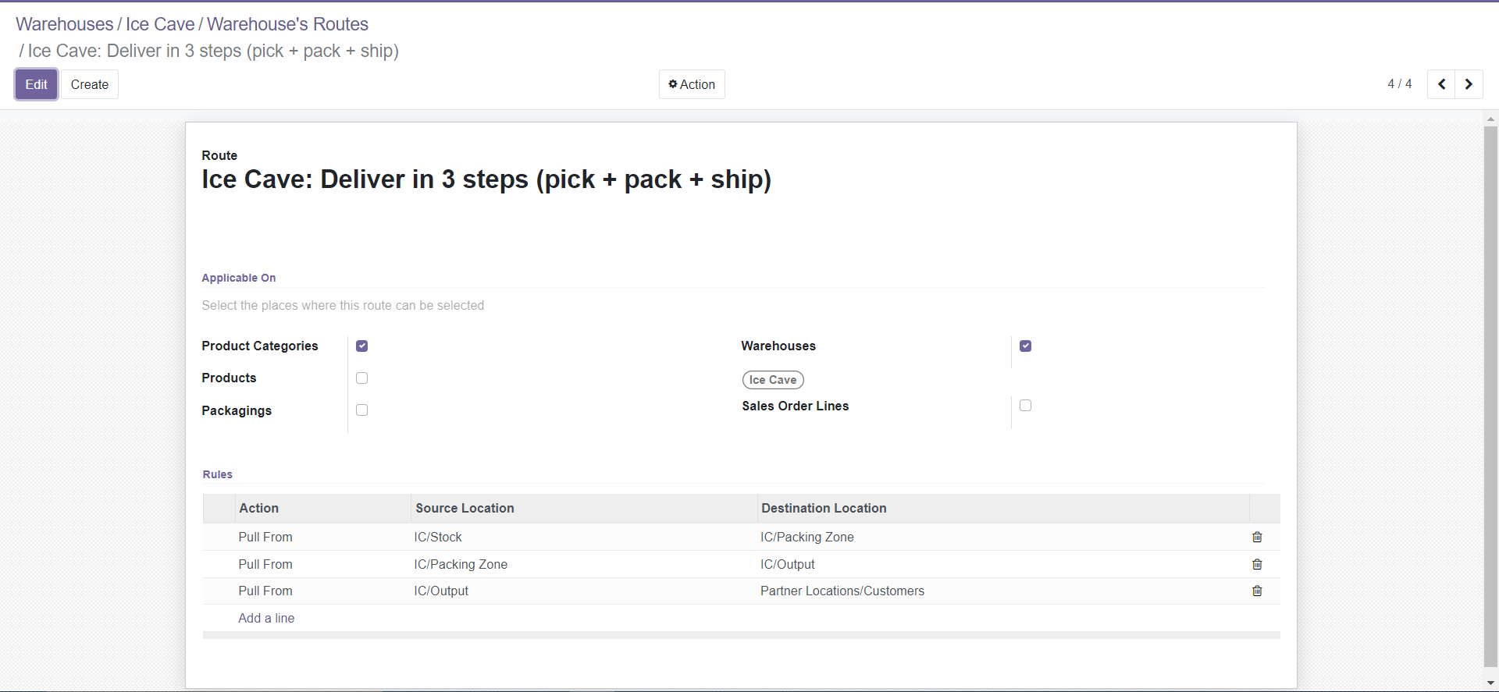
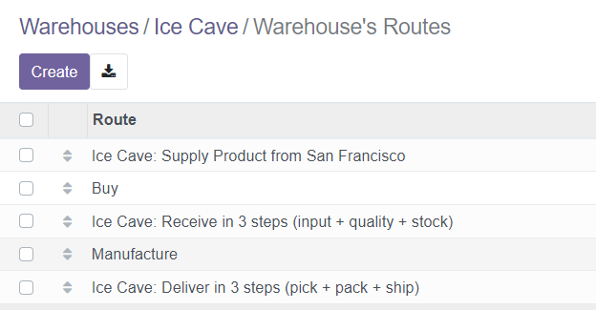
Configuration -> Warehouse Management
Routes

Slide 20
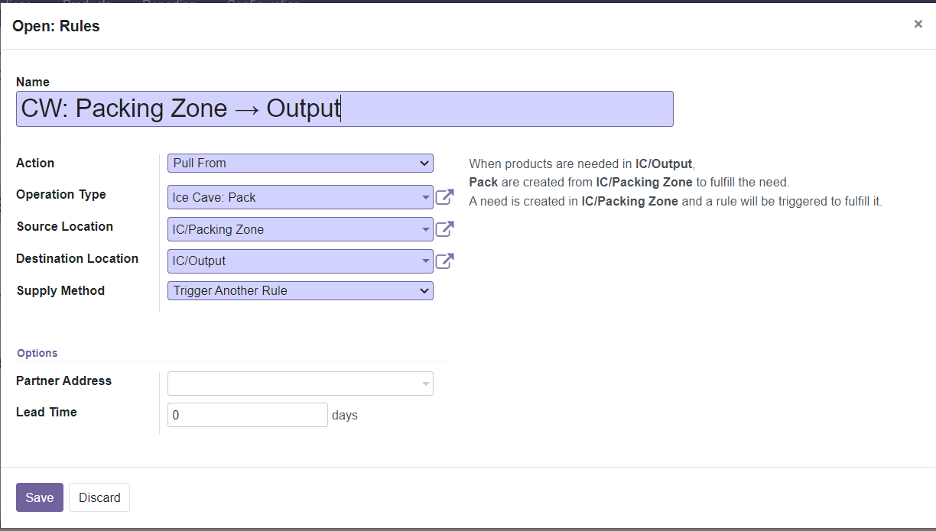
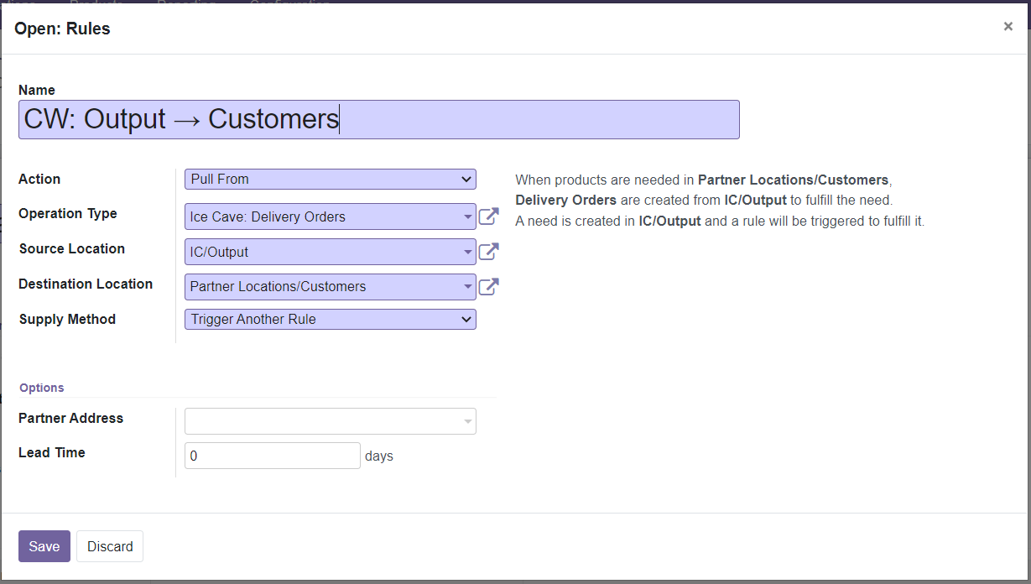
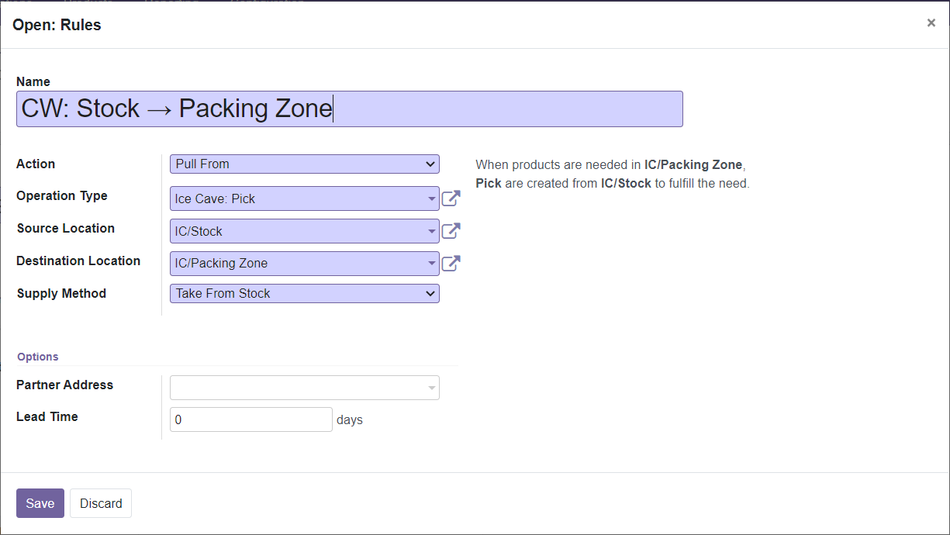
Configuration -> Warehouse Management
Rules

Slide 21
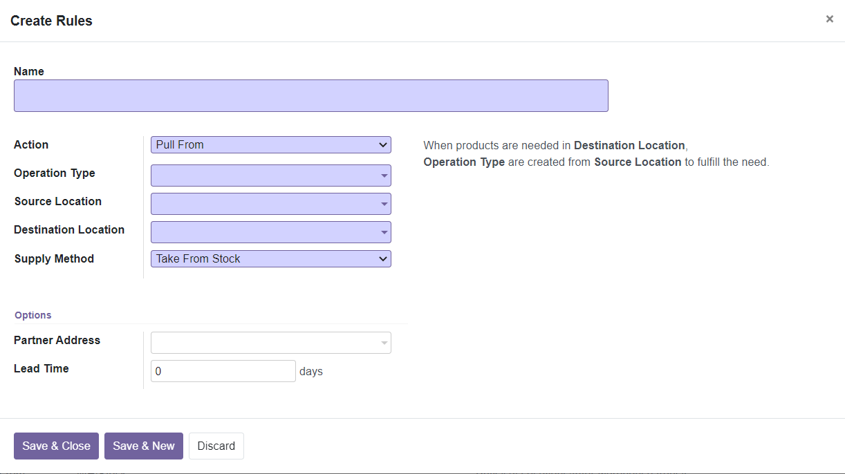
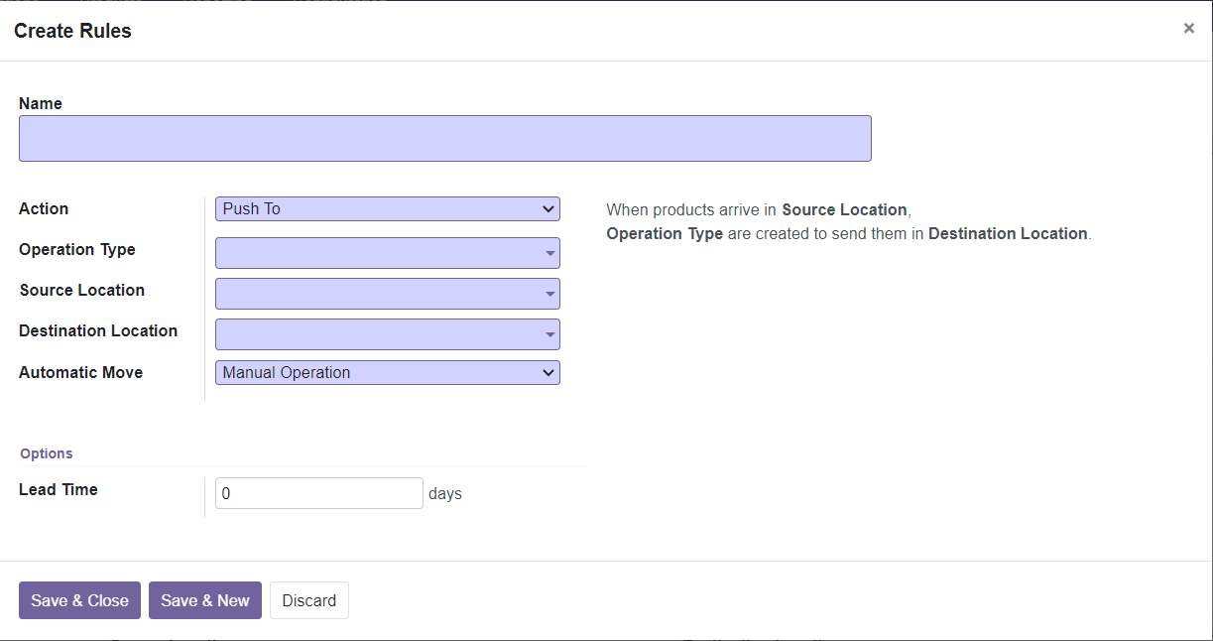
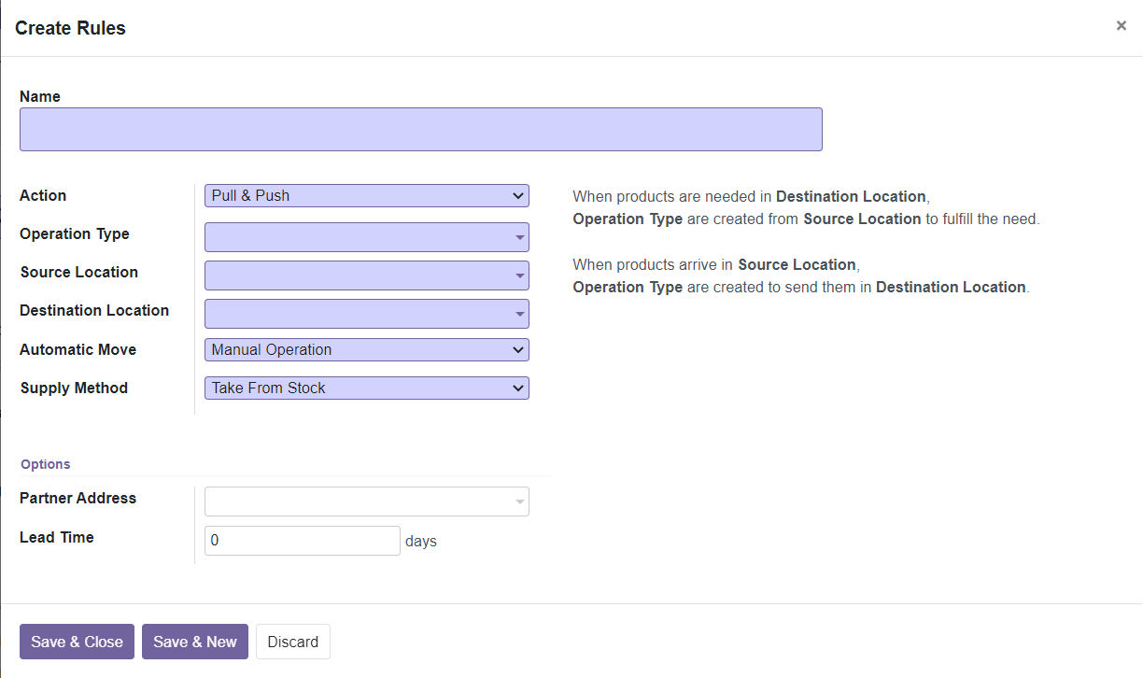
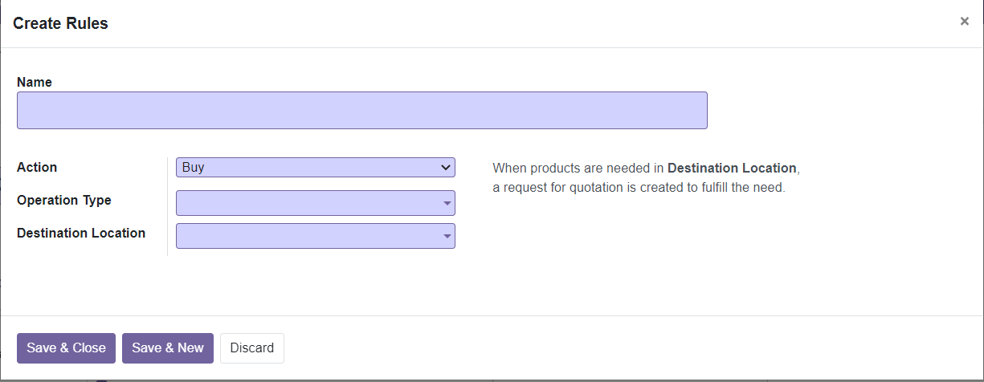
Configuration -> Warehouse Management
Rules
Take From Stock
Trigger Another Rule
Take From Stock, if unavailable, Trigger Another Rule
Manual Operation
Automatic No Step Added

Slide 22
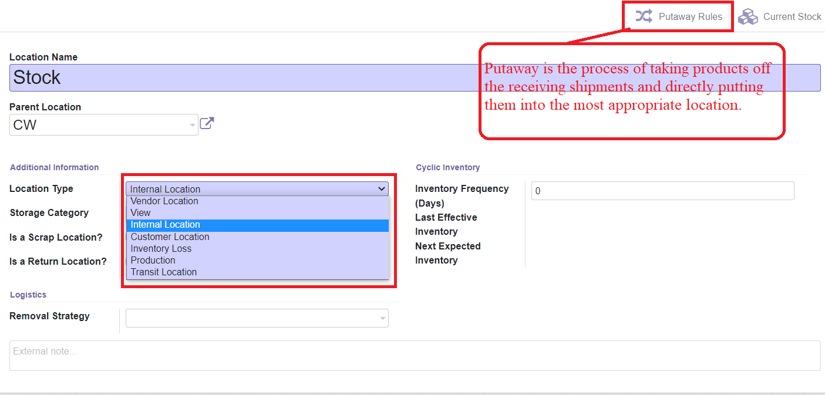
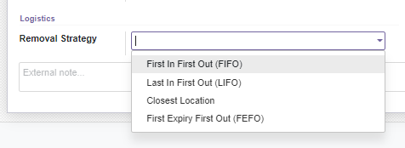
Configuration -> Warehouse Management
Locations

Slide 23
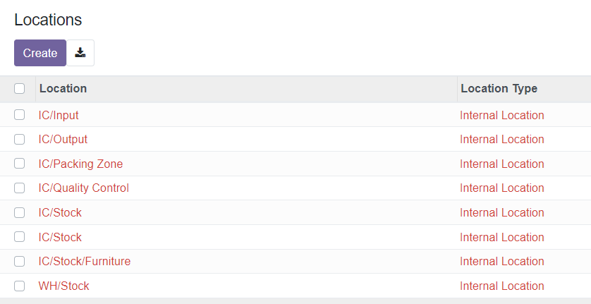
Configuration -> Warehouse Management
Locations
Notes:
ဟယ်လို

Slide 24
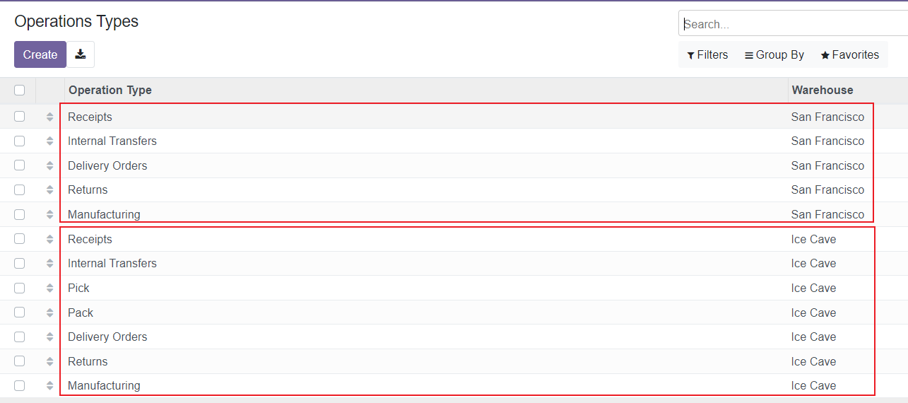
Configuration -> Warehouse Management
Operation Types

Slide 25
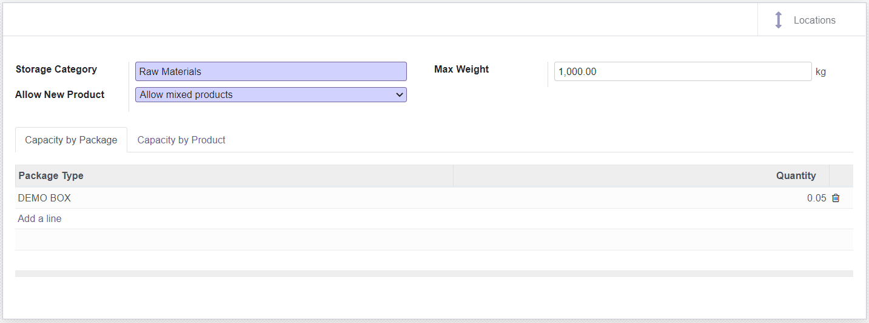
Configuration -> Warehouse Management
Storage Categories
If the location is empty
If all products are same
Allow mixed products

Slide 26
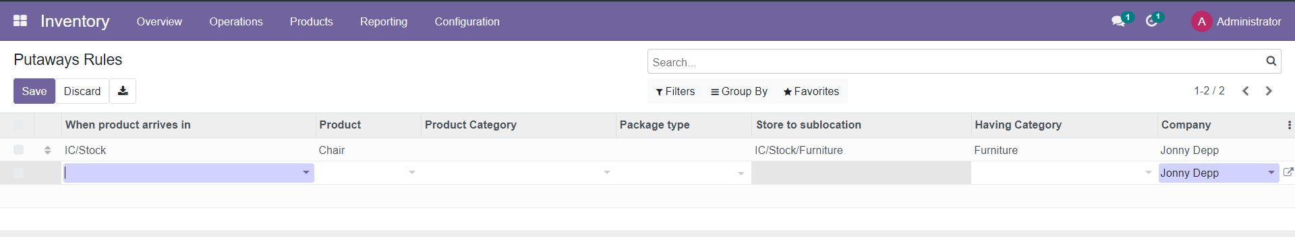
Configuration -> Warehouse Management
Putaways Rules

Slide 27
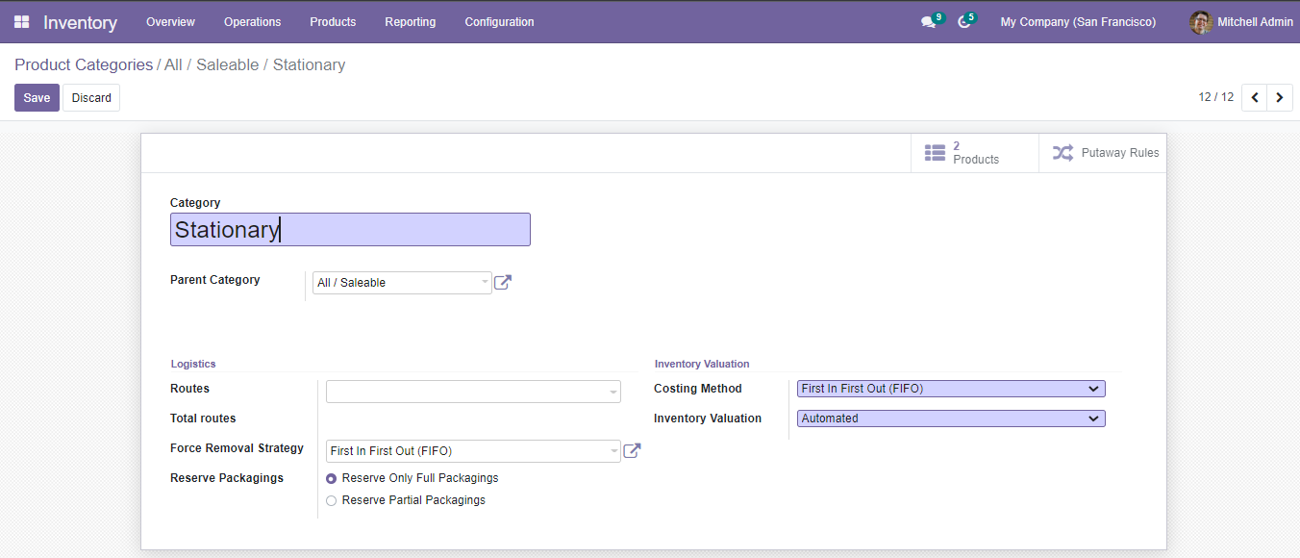
Configuration -> Products
Product Categories
Standard Price
First In First Out (FIFO)
Average Cost (AVCO

Slide 28
Inventory Valuation
Inventory valuation refers to how you value your stock.
Costing Methods:
Standard Price,
First In First Out (FIFO),
Average Price (AVCO)

Slide 29
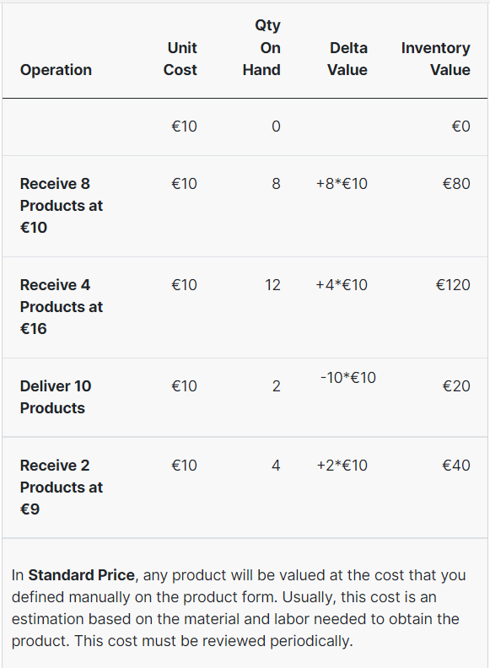
Inventory Valuation => Costing Method
Standard Price

Slide 30
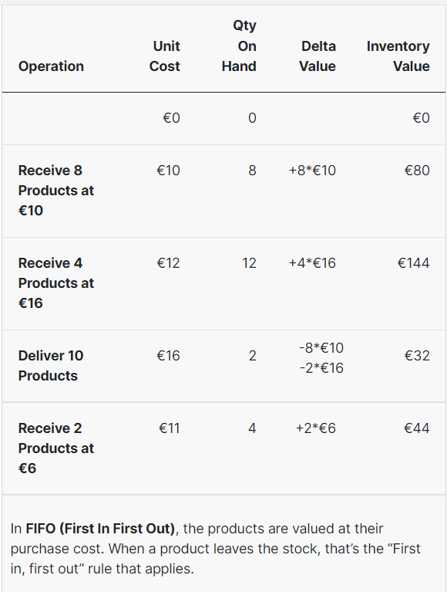
Inventory Valuation => Costing Method
FIFO

Slide 31
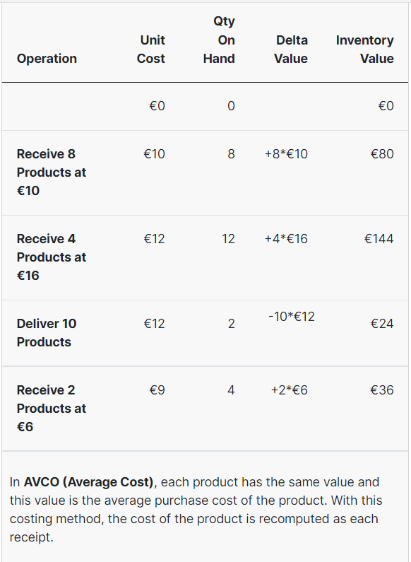
Inventory Valuation => Costing Method
Average cost

Slide 32
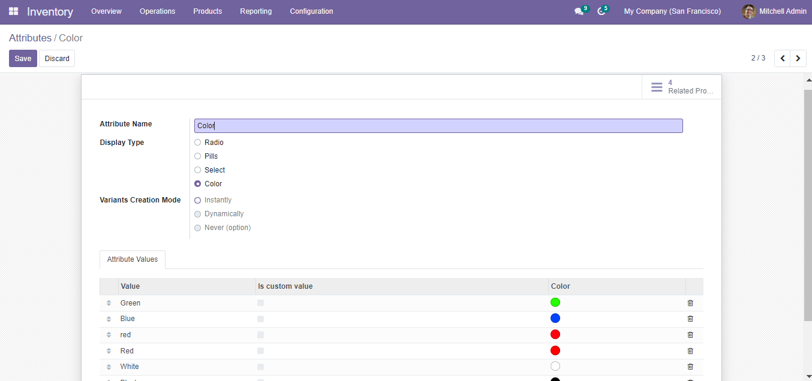
Configuration -> Products
Attributes

Slide 33
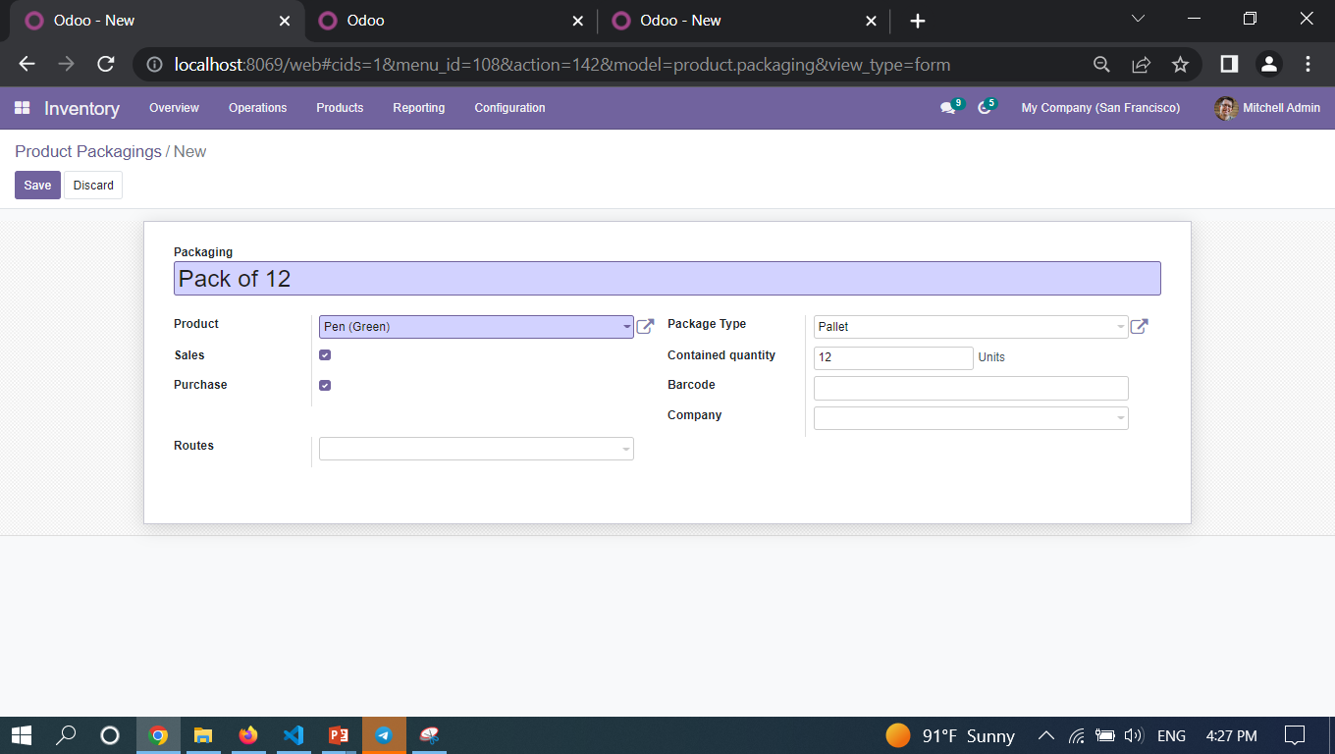
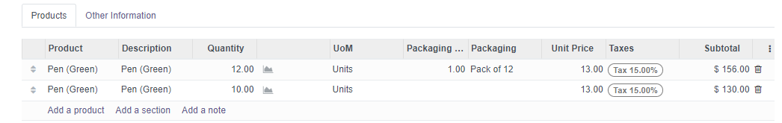
Configuration -> Products
Product Packaging

Slide 34
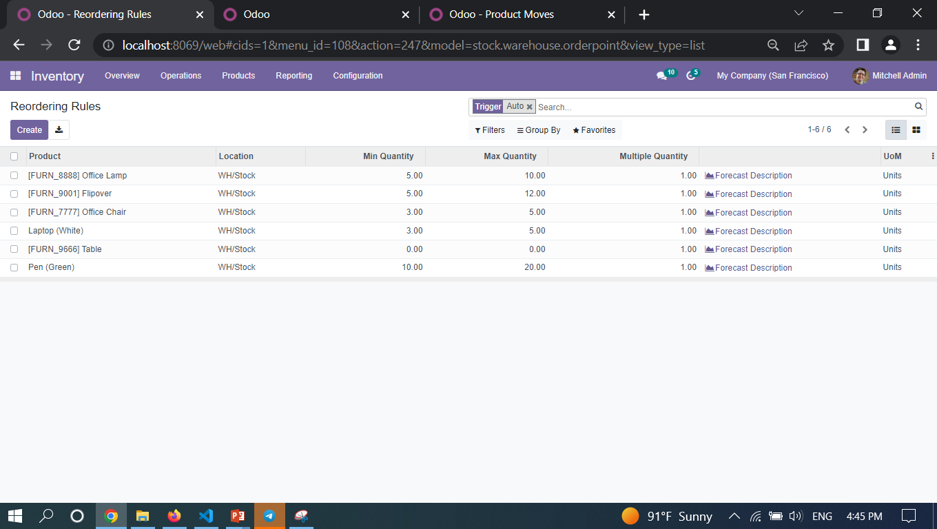
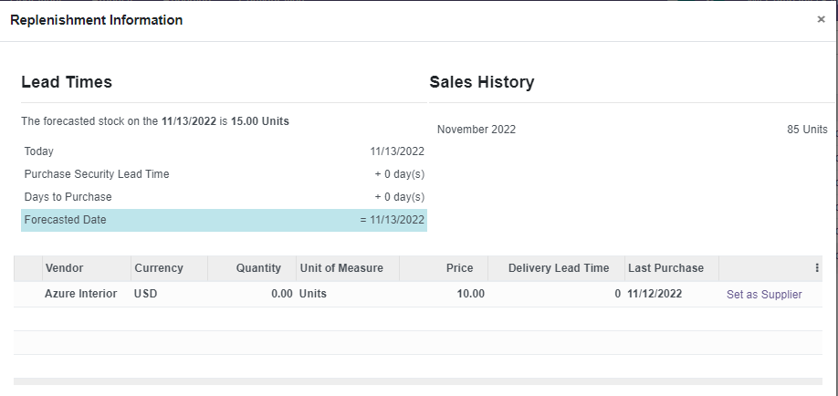
Configuration -> Products
Reordering Rules

Slide 35
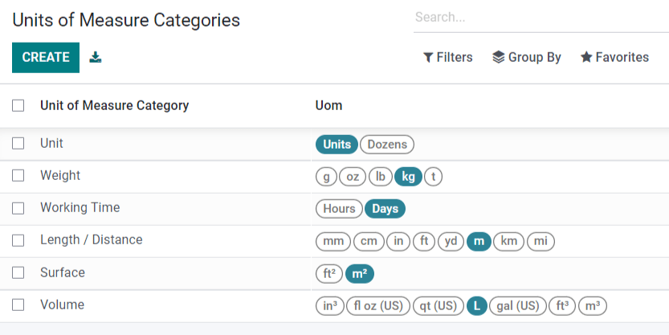
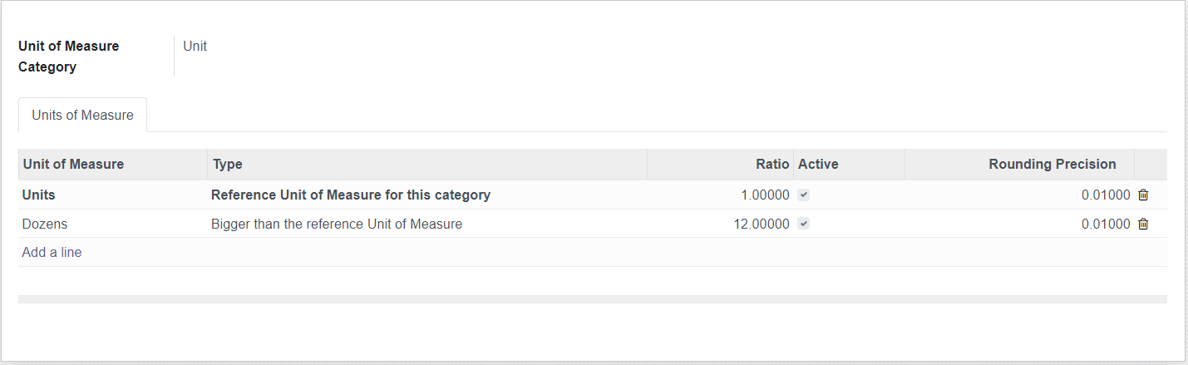
Configuration -> Units of Measures
Units of measure specify the unit used to handle a product.

Slide 36
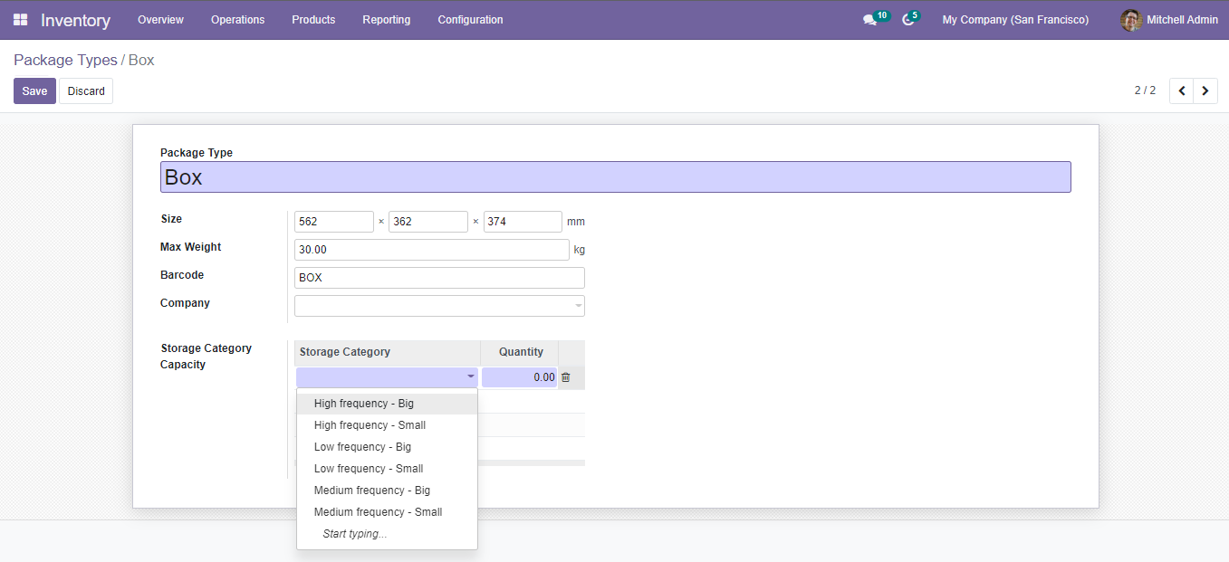
Configuration -> Delivery
Package Types

Slide 37
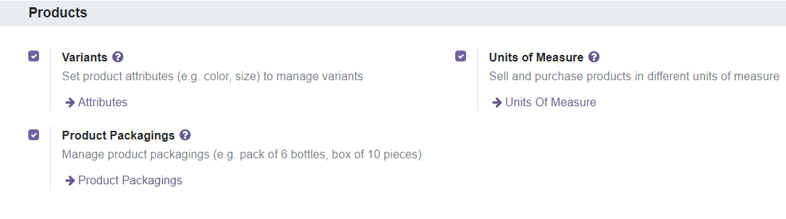
Configuration -> Setting
Product Setting Configuration

Slide 38
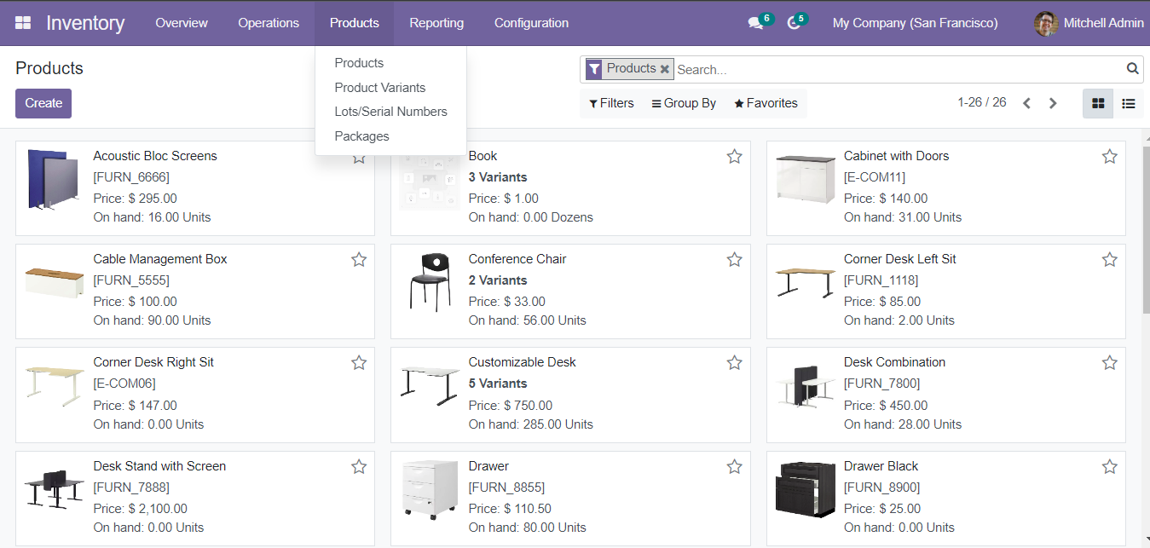
Products in Inventory

Slide 39
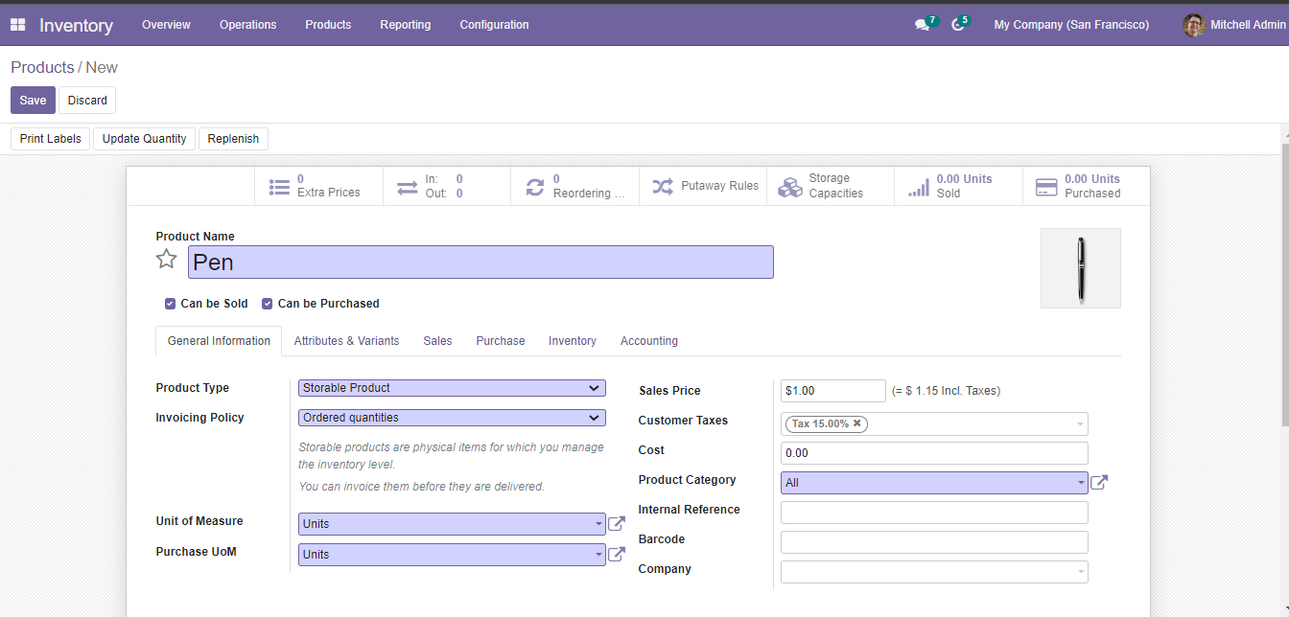
Products in Inventory
Creating New Product

Slide 40
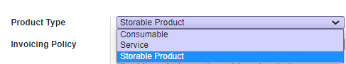
Products in Inventory
Types of Product
Consumable Product - Consumables are physical products for which you don't manage the inventory level: they are always available.
Storable Product - Storable products are physical items for which you manage the inventory level.
Service Product - A service is a process that is intangible.

Slide 41
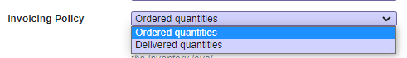
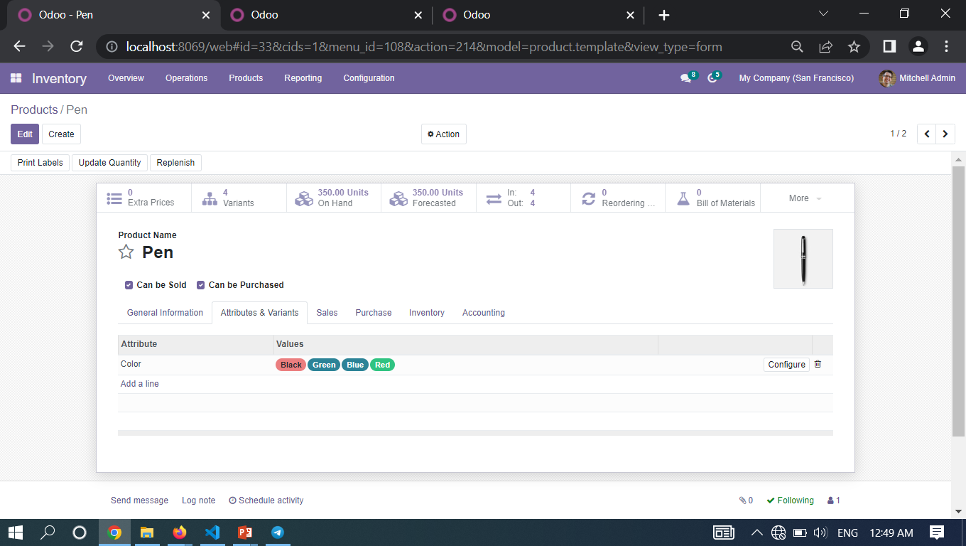
Products in Inventory
Invoicing Policy
Attributes & Variants

Slide 42
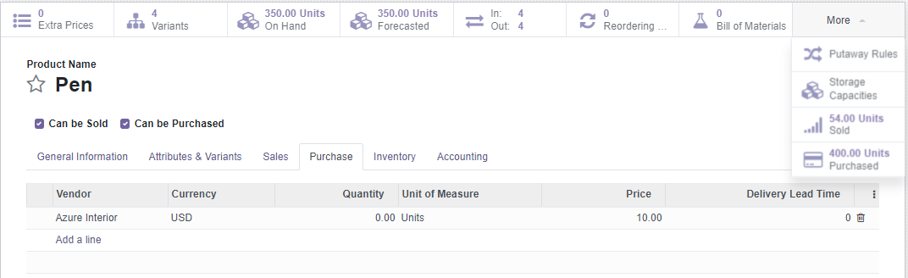
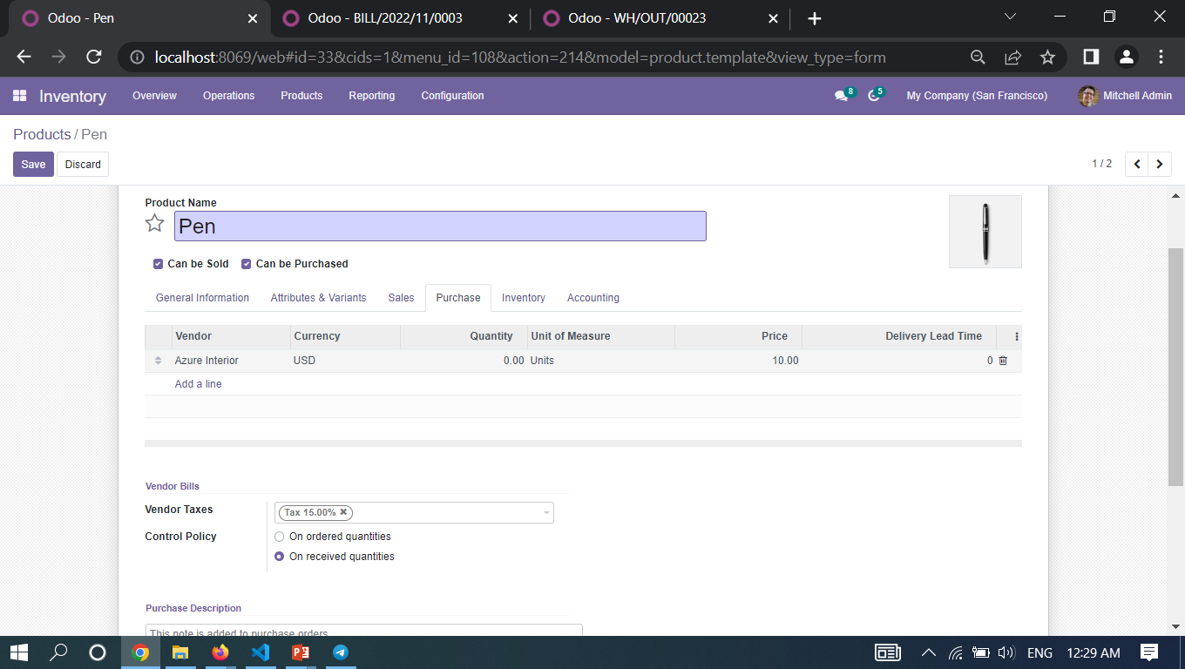
Products in Inventory
Purchase Tab In Product Creation Form

Slide 43
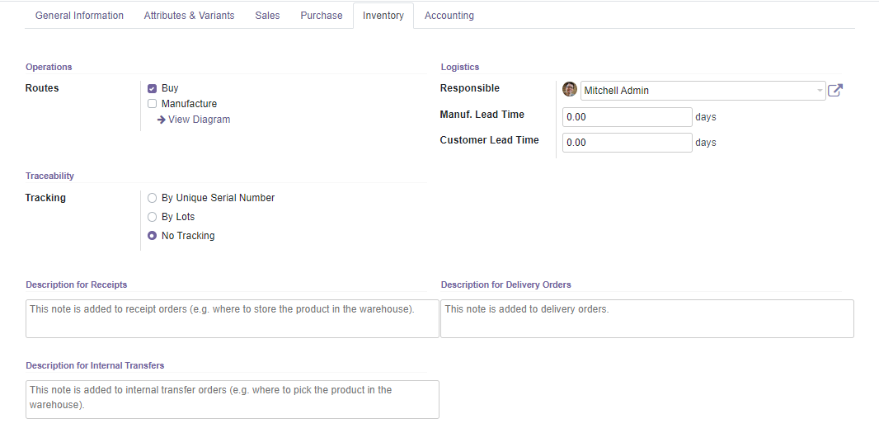
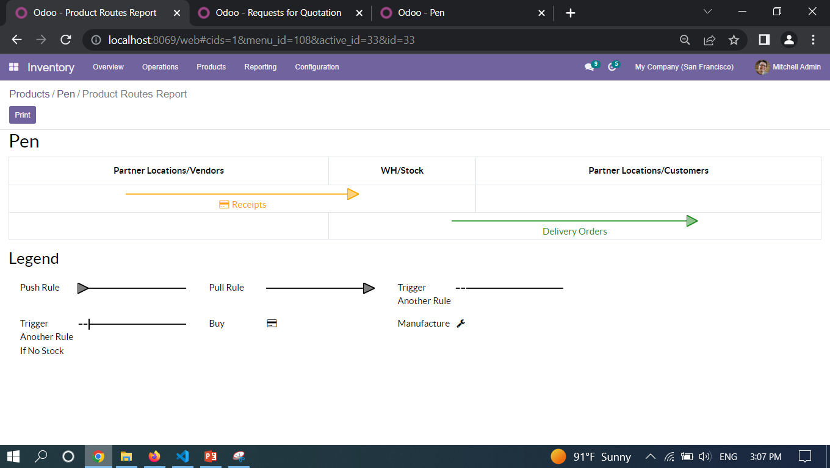
Products in Inventory
Inventory Tab In Product Creation Form
View Route Diagram

Slide 44
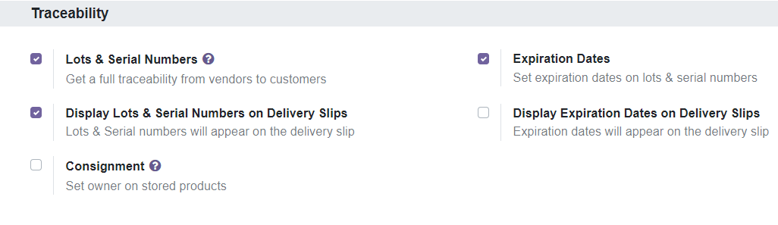
Configuration -> Setting
Traceability Setting Configuration

Slide 45
Traceability
To track each and every operation of manufacturing and distribution of the products.
This will be an essential feature that must be needed for any software dealing with the company inventory.
Tracking by Lots Method Used
No Tracking Methods Used
Lots n*1 – 5 Products
OR
Product 1
Product 2
Product 3
Product 4
Product 5
Lots n*1 – 3 Products
Lots n*2 – 2 Products

Slide 46
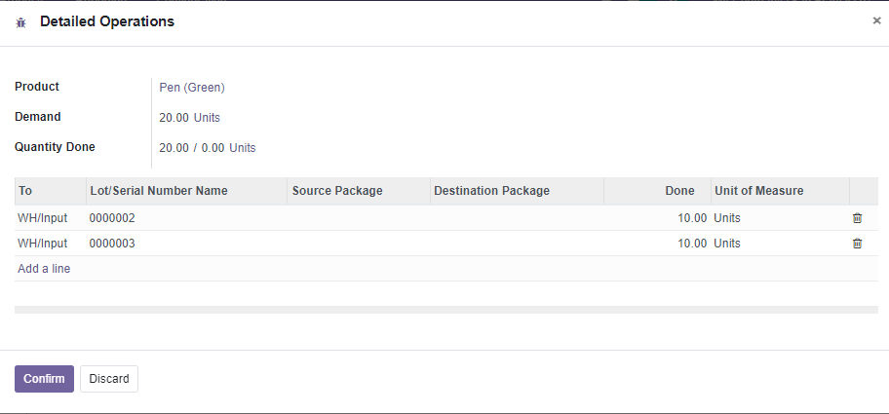


Products in Inventory -> Lots/Serial Numbers
Products in Inventory
Inventory Tab In Product Creation Form
Inventory Tab In Product Creation Form

Slide 47



Products in Inventory -> Lots/Serial Numbers
Inventory Tab In Product Creation Form

Slide 48

Configuration -> Setting
Operation Setting Configuration

Slide 49

Inventory Operations

Slide 50


Inventory Operations -> Transfers
List view of Transfers
Create new Transfer

Slide 51



Inventory Operations -> Batch Transfers

Slide 52

Inventory Operations -> Replenishment

Slide 53

Inventory Operations -> Inventory Adjustment

Slide 54

Inventory Operations -> Scrap

Slide 55

Configuration -> Setting
Valuation Setting Configuration

Slide 56


Inventory Operations -> Landed Costs

Slide 57


Inventory Operations -> Landed Costs

Slide 58

Inventory Operations -> Run Scheduler
The Scheduler runs once daily.
But you can trigger it manually as needed.
Odoo uses the Scheduler to prioritize and plan both purchasing and production, based on the rules you define.
Within Inventory, the Scheduler will automate tasks such as validating reserved products.

Slide 59





Reporting

Slide 60

Summary
How the ERP software works in relation to the basic business processes and functions .
Hope you know why should we use Odoo Business Suite for your organization.
Inventory module of Odoo
  How to manage lead times, automate replenishments, and configure advanced routes like drop-shipping, cross-docks, etc.
60

Slide 61

Thank You

